Slide 1
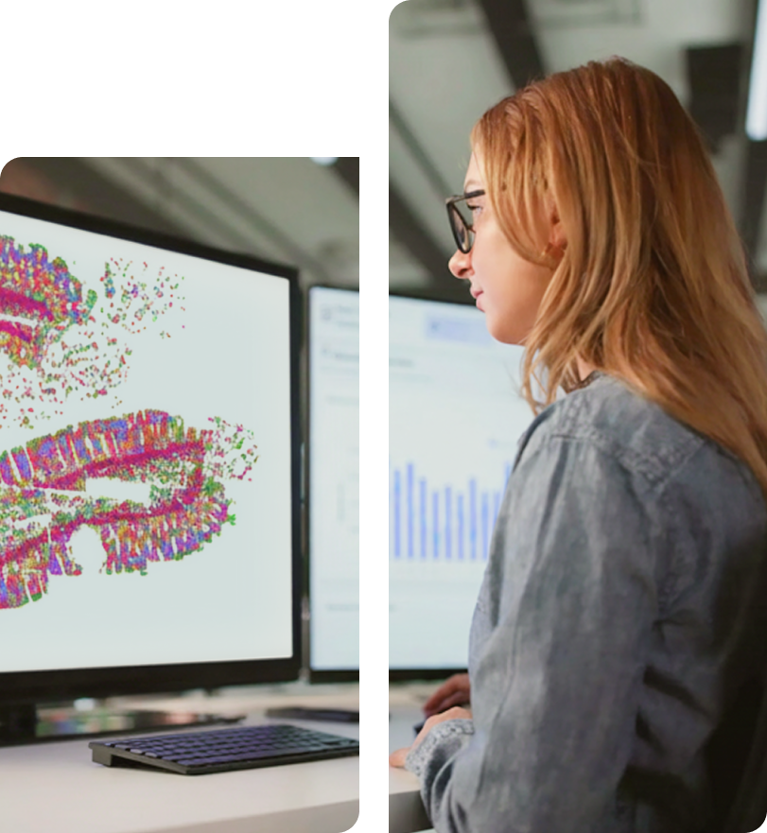
Akrivia Health / Global Minds Proteomics Update
Julie Segueni, PhD, Bioinformatics
Kevin Blighe, PhD, Bioinformatics
Corey Oravetz, CSM, Project Manager​
Shahraz Niwaz, MSc , Business Account Manager
2026-May-12

Slide 2
Agenda
Action Items
Bio Updates
Open Q&A / Discussion
Timeline / Gantt
Month 2026
00

Slide 3
Action Items

Slide 4
Action Items
Action Items from 2026-May-05 Meeting
Joe: Confirm onboarding details needed to grant access to Julie – COMPLETED
Julie: Check that the pathways are correctly aligned with the associated genes (specifically monoatomic ion transport). - COMPLETED (IN SLIDES TODAY)
Julie: Conduct some color coding to show what proteins come from the Inflammation vs CNS panel and confirm the positive regulation of monoatomic ion transport. - COMPLETED
Julie: Finalize the adjusted vs non-adjusted comparison and compare effect sizes between the Somascan and NULISA datasets. - COMPLETED
Julie: Perform ML clustering analysis merging the Somalogic and NULISA datasets with dementia patients removed. - COMPLETED
Kevin: Share slides from the Chris Whelan UKBB trans-diagnostic panel analysis done previously. - COMPLETED
Joe: Discuss offline with Erin the use of the UKBB as an external dataset for comparison. - COMPLETED
FYI – Julie pursuing different presentation material to comply with Conference Deadlines – Now Rancho specific

Slide 5
Action Items
Action Items from 2026-Mar-31 Meeting
Julie: Start analysis of new dataset and compare Somalogic dataset to NULISA dataset - COMPLETED
Julie: Proposed building a diagnostic prediction model using proteomic features to classify patients by disease – DEPRIORITIZED/REMOVED
Joe: Follow up with Kris Rhodes and others in JnJ about prior analysis files. - IN PROGRESS
Farzad: Discuss with Lisa on plan for clinical data analysis. - COMPLETED
Joe: Presentation of dataset and analysis plan (NULISA) - COMPLETED
Action Items from 2026-Mar-17 Meeting
Joe: Circle back and confirm that sharing subject IDs from the Akrivia database without other associated data is approved by the broader group. - REMOVED
Action Items from 2026-Feb-10 Meeting
Joe: Provide Julie with any details about the normalization process that was applied to one of the data files - REMOVED
Joe: Check on the progress of clinical data analysis and share any relevant co-morbidities or self-reported information that might be useful for differential analysis in next week's meeting – REMOVED

Slide 6
Bio Updates

Slide 7
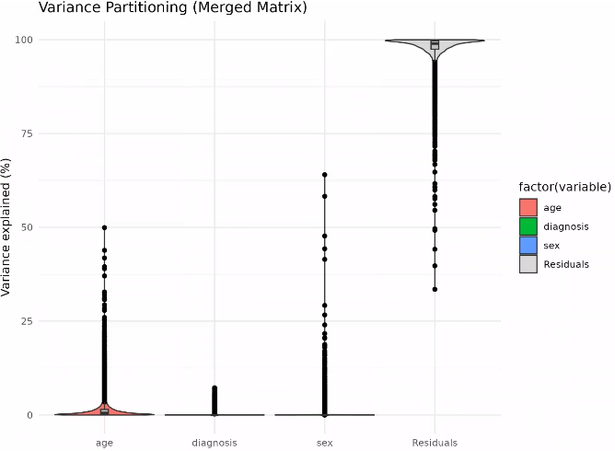
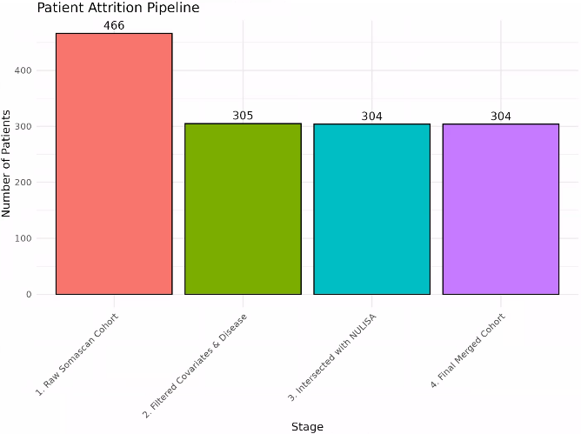
Overview of merged Somascan + NULISA dataset
Included diagnoses: Bipolar disorder, Depressive disorder, Psychotic disorder, Schizophrenic disorder
Using merged Somascan + NULISA dataset

Slide 8
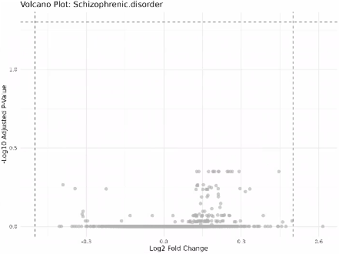
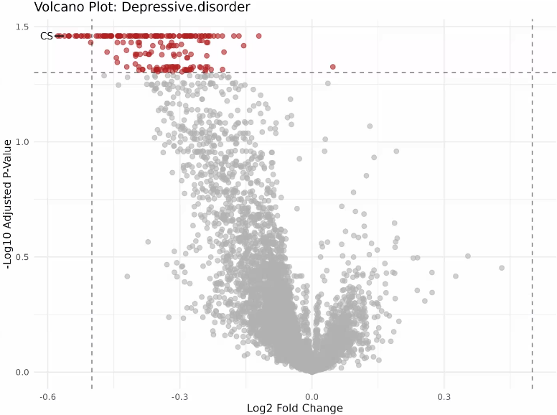
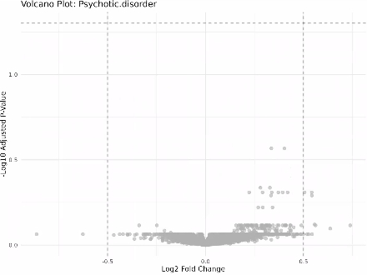
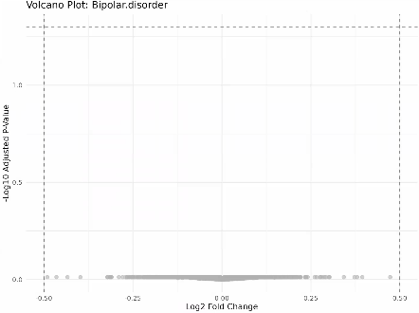
DA results adjusting for Age and Sex
Included diagnoses: Bipolar disorder, Depressive disorder, Psychotic disorder, Schizophrenic disorder
Using merged Somascan + NULISA dataset

Slide 9
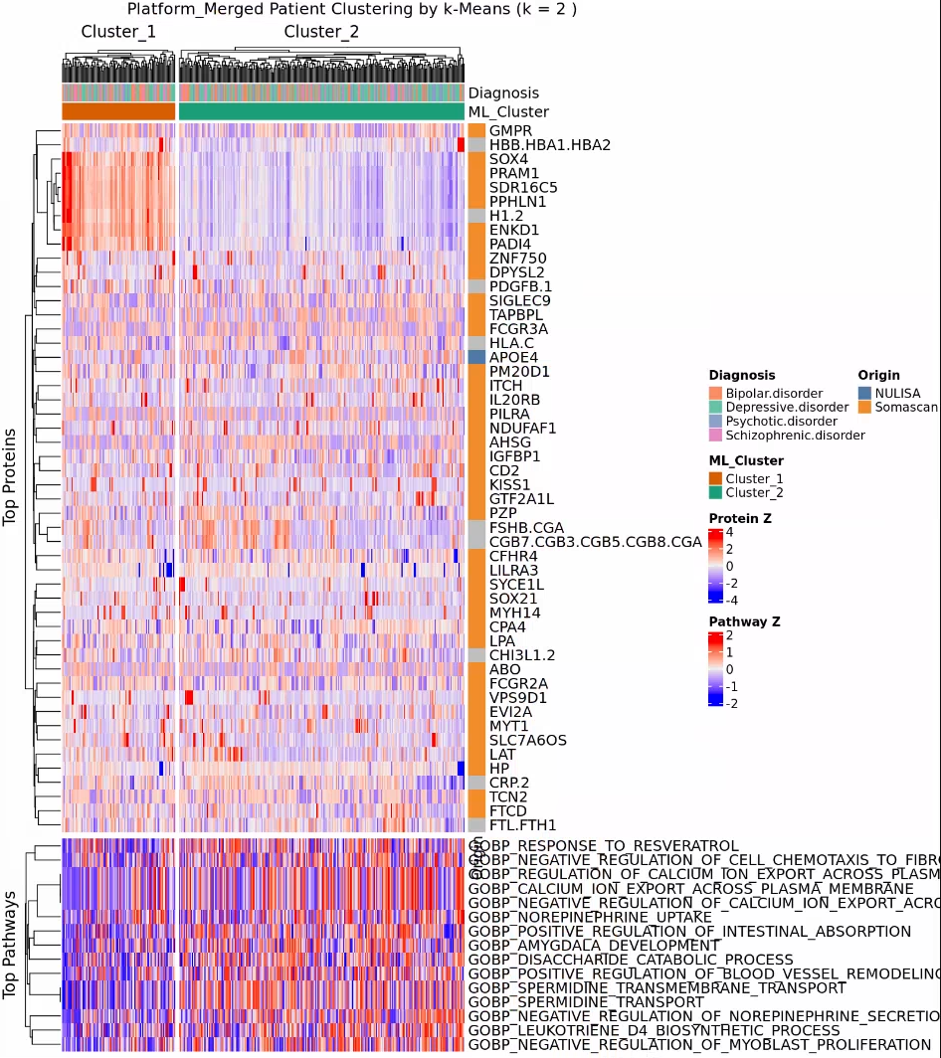
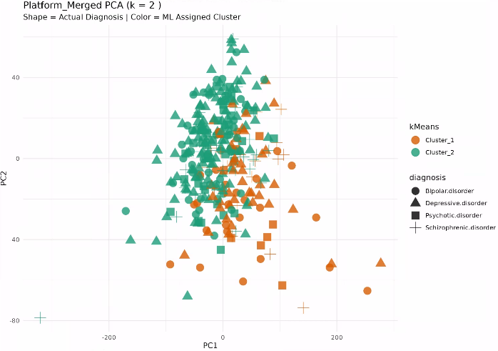
Clustering results with 2 clusters
Included diagnoses: Bipolar disorder, Depressive disorder, Psychotic disorder, Schizophrenic disorder
Using merged Somascan + NULISA dataset
Tested number of clusters k = 2

Slide 10
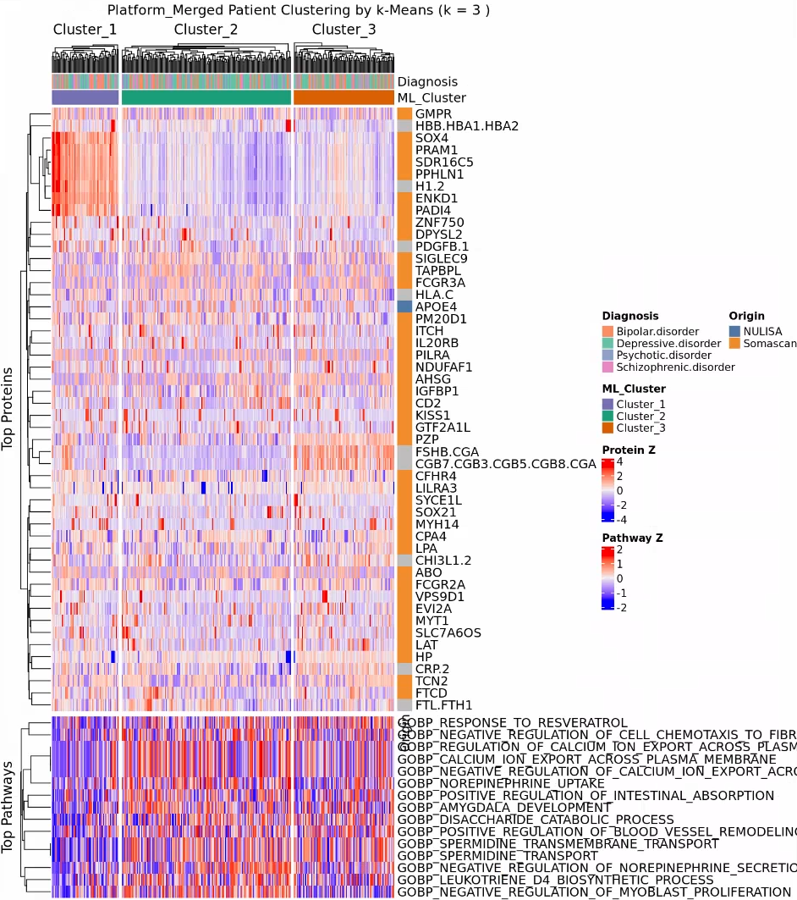
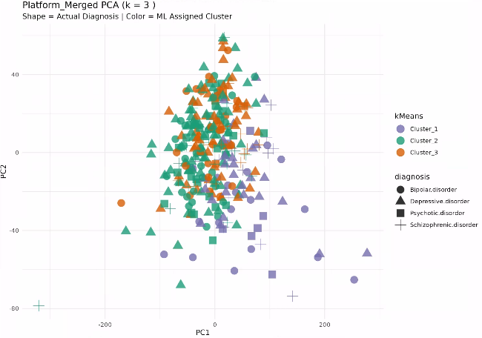
Clustering results with 3 clusters
Included diagnoses: Bipolar disorder, Depressive disorder, Psychotic disorder, Schizophrenic disorder
Using merged Somascan + NULISA dataset
Tested number of clusters k = 3

Slide 11
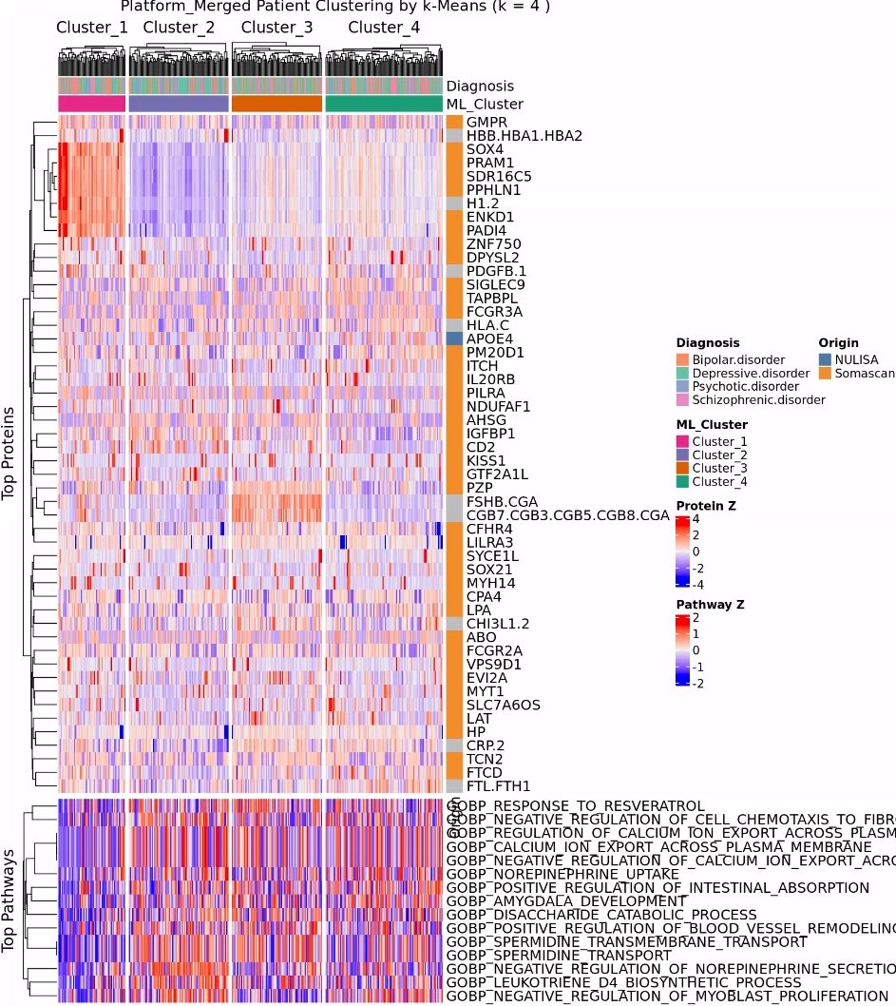
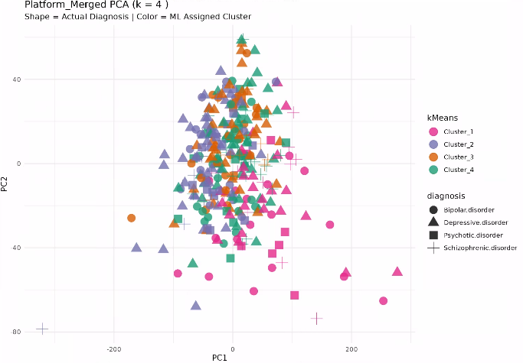
Clustering results with 4 clusters
Included diagnoses: Bipolar disorder, Depressive disorder, Psychotic disorder, Schizophrenic disorder
Using merged Somascan + NULISA dataset
Tested number of clusters k = 4

Slide 12
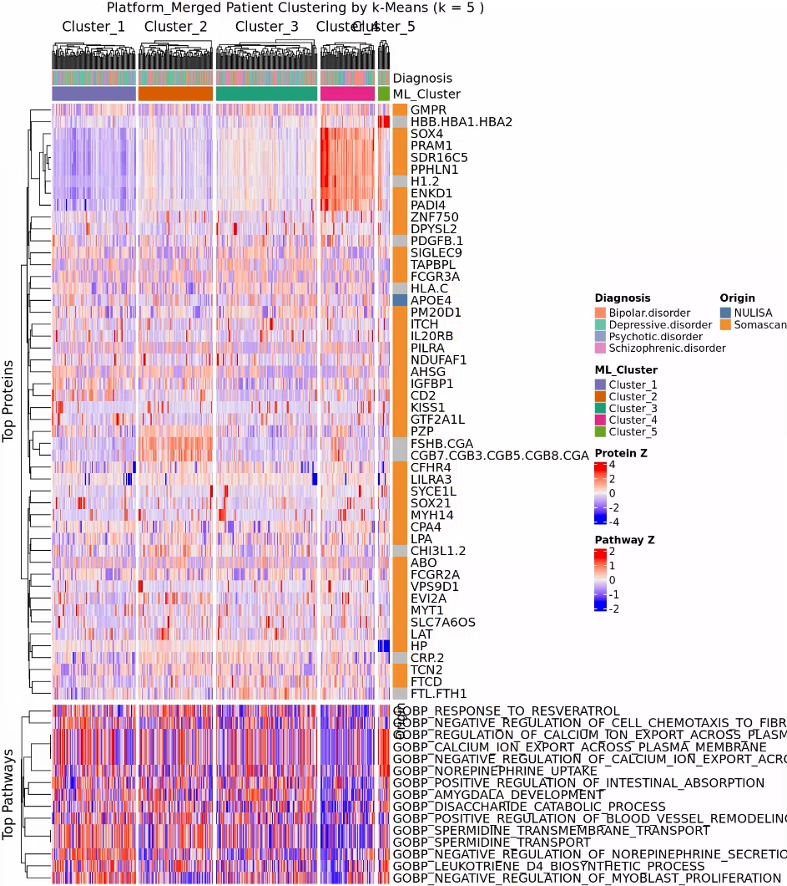
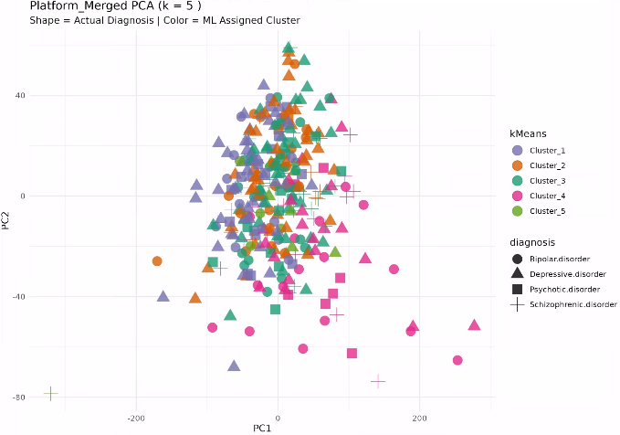
Clustering results with 5 clusters
Included diagnoses: Bipolar disorder, Depressive disorder, Psychotic disorder, Schizophrenic disorder
Using merged Somascan + NULISA dataset
Tested number of clusters k = 5

Slide 13
Next Steps, Timelines, Further Analysis
What should be our next steps? Recommendations:
Finalize clustering
Akrivia onboarding with Naser
Setting up + clinical data review
Expected timelines?
When to expect Clinical Data access/export and availability for analysis?

Slide 14
Timeline & Deliverables

Slide 15
J&J: Akrivia Health SomaLogic Proteomics Analysis
Timeline
Today
2026
Feb
Mar
Apr
May
Jun
Feb 3 - Feb 9
5 days
Onboarding, Environment Setup, Data Import into Domino
2026
Feb 10 - Feb 13
4 days
Data Normalization & QC
Feb 16 - Feb 23
6 days
Diff Abundance Analysis (DAA)
Global Minds / Akrivia Proteomics Analysis
Feb 24 - May 11
Pathway Analysis + Variance Partitioning Analysis, Removing Dementia Patients, Clustering, NULISA Analysis
55 days
Access to Akrivia + Onboarding
2 w
May 12 - May 25
Compare Treatment-Resistant Patients vs Responders
May 26 - Jun 8
10 days
Correlate Proteomics Levels to Clinical Data
10 days
Jun 9 - Jun 22
Reporting & QC
2 days
Jun 23 - Jun 24
Timeline
On-Boarding (4 hours)
Data Retrieval, Normalization, & QC (16 hours)
Differential Abundance Analysis (DAA) (24 hours)
Pathway Analysis (24 hours)
Compare treatment-resistant patients vs responders (16 hours)
Correlate proteomics levels to clinical data (12 hours)
Reporting & QC (8 hours)
Total: 104 hours Bioinformatics; 10 hours Project Management.

Slide 16
Archive

Slide 17
Action Items
Action Items from 2026-Mar-31 Meeting
Julie: Review and identify common overlapping signatures and pathways between diseases. - COMPLETED
Julie: Complete upset diagram plot showing common DA proteins across diseases. - COMPLETED
Julie: Perform analysis removing dementia and focusing on the four neuropsychiatric disorders. - COMPLETED
Julie/Corey: Send the slides to the team after the meeting. - COMPLETED, 2026-Mar-31

Slide 18
Action Items
Action Items from 2026-Mar-17 Meeting
Julie: Ask Kevin about age correction in the previous analysis and obtain the relevant slides - Julie: Create protein abundance heat maps for proteins within enriched pathways from the rich plots. - COMPLETED (NO ACCESS TO FILES OR CODE)
Julie: Create a heat map showing average protein expression per diagnosis (bipolar disorder, dementia, depressive disorder, psychotic disorder) for the DA proteins. - COMPLETED
Action Items from 2026-Mar-10 Meeting
Julie: Extract proteins within the ridge plot peaks and plot them on raw abundance heatmaps. - COMPLETED

Slide 19
Action Items
Action Items from 2026-Mar-10 Meeting
Julie: Redo DA analysis and Pathway analysis using Age as covariate – COMPLETED, 2026-Mar-17
Julie: Color the volcano plot by identified pathway membership to show distribution of effect sizes per pathway. - COMPLETED, 2026-Mar-17
Julie: Provide new plots showing raw pathway-level abundances using dementia as a reference group across all diseases. - COMPLETED, 2026-Mar-17
Joe: Check-in with Alessandra that the budget and spend are acceptable if the project timeline extends. - COMPLETED, 2026-Mar-17
Action Items from 2026-Feb-24 Meeting
Julie: Pathway analysis from DAA results – COMPLETED, 2026-Mar-09
Action Items from 2026-Mar-17 Meeting
Julie: Julie to consider further analysis during the DAA that can statistically validate the absence of bias effects - COMPLETED, 2026-Mar-17
Julie: Start on the DAA process – COMPLETED, 2026-Feb-23
Action Items from 2026-Feb-10 Meeting
Joe: Joe to reach out to Akrivia to get clarification about the 17 samples labeled as 'other' - COMPLETED, 2026-Mar-17
Julie: Start on the QC and normalization process – COMPLETED, 2026-Feb-13

Slide 20
Action Items
Action Items from 2026-Feb-03 Meeting
Joe: Provide access to the MS Teams folder with the clinical XLS files – COMPLETED, 2026-Feb-06
Farzad: Create a new Domino project and upload the proteomics data files for the analysis – COMPLETED, 2026-Feb-03
Corey: Setup weekly calendar cadence for the team to meet – COMPLETE, 2026-Feb-03

